Slide 1
VA DD Waiver Quality Assurance Program: Quality Review Team (QRT)
2021 EOY Report to the QIC
Deanna L. Parker, MPA
Policy and Compliance Manager
DBHDS Vision: A life of possibilities for all Virginians
Notes:
Summary

Slide 2
Background: Waiver Assurances
A – Administrative Authority - The State Medicaid agency is involved in the oversight of the waiver and is ultimately responsible for all facets of the program.
B - Level of Care - Persons enrolled in the waiver have needs consistent with an institutional level of care.
C - Service Plan - Participants have a service plan that is appropriate to their needs and services/supports are delivered as specified in the plan.
D - Qualified Providers - Waiver providers are qualified to
deliver services/supports.
G - Health and Welfare - Participants’ health and welfare is
safeguarded and monitored.
I - Financial Accountability - Claims for waiver services are paid
according to state payment methodologies.
Notes:
All states operating §1915c Home and Community Based (HCBS) Waivers program must have a Quality Assurance and Improvement System that measures ongoing waiver performance according to 6 overarching waiver assurances.”
These six assurances represent broad categories under which states demonstrate that they meet a minimum level of compliance reflecting system quality.
All of our waiver performance measures fall under one of these assurance)

Slide 3
Let’s Talk About the Data
Data represents 2021 averages across all three waivers
population.
QMR Sampling Methodology: provider, service, and individual record level.
Data represents a snapshot of compliance for a PM; different
providers sampled each quarter.
Trends inferred when persisting over several quarters or years.
Improvements in performance typically demonstrated over 2-3 quarters or a year’s review.
Remediation required to be implemented each quarter (6 months max per DOJ SA).
Notes:
Important to understand the data – what is does and does not represent and subsequent limitations.)
2021 averages of ALL PM’s across all three waivers combined,
Over 70% of data sources are from the DMAS QMR reviews.
sample of individuals in all three DD waivers;
DMAS claims data and information gathered from case management records and the Plans for Supports from service providers.
QMR sampling methodology is first looking at providers of individual services, then applying a formula to determine how many individual records to pull from that provider delivering a particular service under review in the sample.
Sampling methodology different providers are sampled each quarter which can impact the overall compliance of that PM.
Some providers more knowledgeable about waiver requirements than others (mom and pop provider) they can skew the percentages
The number of records also impacts the sample (large CSB with a SC who made the same error over a number of records)
Small sample sizes affect compliance as well.
There will always be some degree of noncompliance for any measures using QMR data.
Noncompliance not considered a trend needing systemic remediation unless repeated over several quarters or more.
Similarly, performance improvement, particularly delivered as a systemic solution, must be demonstrated and sustained over time.
Under the SA, the QRT has six months from discovery of low compliance, to remediate. The QRT is reviews data a full quarter behind the current quarter, remediation is actually occurring EACH quarter.

Slide 4
Results: Overall PM Compliance
Percentage PM's Met vs. Not Met SFY 2021
16%
Total Not Met
Total Met
84%
Notes:
For SFY 2021, 84% of the measures were compliant, with 16% noncompliant.
Let’s take a closer look at the noncompliant PM’s.

Slide 5
PM’s Below Compliance SFY 2021
Performance Measure C8: Number and percent of provider agency staff meeting provider orientation training requirements (DMAS)
Performance Measure C9: Number and percent of provider agency direct support professionals (DSPs)
meeting competency training requirements.
Performance Measure D1: Number and percent of individuals who have Plans for Support that address
their assessed needs, capabilities and desired outcomes. (DMAS)
Performance Measure D3: Number and percent of individuals whose Plan for Supports includes a risk
mitigation strategy when the risk assessment indicates a need.
Performance Measure D6: Number and percent of individuals whose service plan was revised, as needed, to address changing needs.
Performance Measure D9: Number and percent of individuals who received services in the type specified in
the service plan
Performance Measure G1: Number and percent of closed cases of abuse, neglect, exploitation for which
DBHDS verified that the investigation conducted by the provider was done in accordance with regulations.
Performance Measure G4: Number and percent of individuals who receive annual notification of rights and information to report ANE
Performance Measure G10: Number and percent of participants 19 years and younger who had an ambulatory or preventive care visit during the year.
Notes:
High level overview of the 9 performance measures out of compliance for SFY 2021.
C8 and C9 go hand in hand. With providers not preparing their teams as required in the regs. We have a couple of QII’s identified to address this problem; however, it is important to note that we are not using data from the QII’’s to determine compliance but will possibly use it as surveillance data in the near future.
D1 Clear needs identified in the plan for which there is no support activity. The individual has expressed a desire to do something or a goal and it is not included in the plan. Looking for at least one support activity/instruction identified to address the assessed need, or desired outcome
D3 ensuring that if a risk is identified in the plan, there is an associated risk mitigation strategy.
D6 long-standing problem – CM’s are not updating the plan when a clear need or opportunity is presented.
D9 Providers unable to document that they have provided services in the appropriate type as outlined in the plan – for any number of reasons.
G1 Founded cases of abuse, neglect and exploitation that were remediated according to the regs.
G4 Providers not able to produce documentation indicating that the individual was notified of his rights, annually.
G10 The state has, thus far - especially since the pandemic, been able to document that individuals are receiving preventive care visits.

Slide 6
2021 QRT Performance Below Compliance
Final SFY 2021 DD Waiver Performance Measures Below 86%
Threshold
Notes:
This slide graphically represents the 9 PMs that are unmet averaged and sorted in ascending order by the percentage unmet. So you see the noncompliance ranges from 60% on the lowest end to 85% on the highest end. Regardless of the percentage noncompliant (G1 85%) – the state is required to implement systemic remediation for any PM which is unmet at the end of the year.

Slide 7
Comparison SFY 20/SFY 2021 PM Performance
86%
86%
99%
92%
67%
66%
Notes:
graphic compares 2020 waiver PM’s below compliance to those below compliance in 2021.
In 2020 there were 8 individual performance measures that were out of compliance (below 86% threshold) In 2021, there were nine
The numbers in red above the bars reflect the percentage change from the previous year. Most PM’s represented improvement, but for C9 and G4 the numbers actually got worse.
So…..in summary:
Three PMs that were noncompliant in SFY 2020 met compliance in SFY 2021.
D4: Number and percent of service plans that include a back-up plan when required for services to include in-home supports, personal assistance, respite, companion, and shared living. 69% vs. 94%
D7: Number and percent of individuals who received services in the frequency specified in the service plan. 79% vs 93%
D11: Number and percent of individuals who received services in the amount specified in the service plan. 82% vs.92%
Five PMs that did not meet compliance in SFY 2020 remain unmet in SFY2021.
C9: Number and percent of provider agency direct support professionals (DSPs) meeting competency training requirements. 63% vs 60%
D1: Number and percent of individuals who have Plans for Support that address their assessed needs, capabilities and desired outcomes. 80% vs 84%
D3: Number and percent of individuals whose Plans for Supports includes a risk mitigation strategy when the risk assessment indicates a need. 72% vs 77%
G4: Number and percent of individuals who receive annual notification of rights and information to report abuse, neglect, and exploitation (ANE). 85% vs. 71%
G10: Number and percent of participants 19 and younger who had an ambulatory or preventative care visit during the year 66% vs. 67%
Four additional PM’s that were compliant in SFY 2020 did not meet compliance in SFY 2021
C8: Number and percent of provider agency staff meeting provider orientation training requirements 86% in 2020 but 78% in 2021
D6: Number and percent of individuals whose service plan was revised, as needed, to address changing needs. 86% in 2020 Vs 75% in 2021
D9: Number and percent of individuals who received services in the type specified in the service plan 99% in 2020 vs 77 in 2021
G1 Number and percent of participants 19 years and younger who had an ambulatory or preventive care visit during the year . 93% in 2020 vs. 85% in 2021

Slide 8
Summary
Demonstrable improvement in provider compliance is contingent on:
The degree and extent to which state staff have access to updated contact information for all providers of DD waiver services in the Commonwealth in order to deliver information, resources, and training on waiver requirements.
The sampling methodology used to review some provider records.
Improvements in data collection, reporting, and remediation tracking via modernized data tools.
Provider accountability for demonstrating quality and related sanctions.
Notes:
So in terms of a summary, we have included essentially the same recommendations as last year with one additional factor. Demonstrable improvement in provider compliance is contingent on:
The degree and extent to which state staff have access to correct/updated contact information for all providers of DD waiver services in the Commonwealth in order to deliver information, resources, and training on waiver requirements. Provider lists are often generated via a combination of DBHDS licensing data, DMAS billing data, and information voluntarily submitted through other electronic systems and platforms. Further, there is no universal location for accessing provider contact information or statewide mandate or regulatory requirement for providers to update their contact information in any statewide system. In addition, provider contact information may be reported differently in each department or electronic platform. Therefore, essential information delivered by the state is reaching only a fraction of the intended population.
The sampling methodology used to review some provider records.
Improvements in data collection, reporting, and remediation tracking via modernized data tools. New QRT APP tool deployed in May but need ongoing resources devoted to pulling down data, fixing bugs and making improvements to the tool.
Provider accountability for demonstrating quality and related sanctions. High degree of failure before money is retracted or they are no longer able to be a provider. Perpetuates long standing problems.

Slide 9
Ongoing Recommendations to the QIC
Develop statewide, intra-agency processes to expand the reach to all DDW providers so that existing first line remediation is more effective.
Develop the capacity within the state for more innovative, on-demand training resources.
Invest in ongoing improvement and maintenance of database solutions to streamline data reporting capability
Notes:
So the recommendations to the QIC are the same, with a few updates.
If there was a reliable way to ensure that we have correct contact information for ALL DDW providers, we could be assured that important communication to providers about trainings and regulatory requirements/clarifications would reach the entire provider population, and not just those providers who opt in to receive notifications. I have been speaking with DMAS about the possibility of capturing monthly, a list of providers who have billed for services through DMAS that could be crosschecked with those on our provider listserv. DMAS is willing to dedicate resources toward this effort and it is my understanding that they will be developing a program to run the report’ however, its earliest implementation would be 2023.
Develop the capacity within the state for more innovative, on-demand training resources. With the waiver regs being finalized, we continue to demonstrate a need for targeted on-demand training resources (video recordings) for providers who fall under the mandatory provider remediation requirement.
Invest in ongoing improvement and maintenance of database solutions to streamline data reporting capability. This request has been modified from last year. The new QRT APP has been launched but a commitment to ongoing support and maintenance of the tool for data analysis, is still needed. As an example, we have historical data in the tool from 2019 to 2022; however, due to errors in some of the data that need to be resolved, I am unable to show you historical trends in the QRT PM’s.
A few very recent new consideration for the work of the QRT is that the CMS has rolled out very recently a sent of standardized performance measures. This is very new as prior to this all states were allowed to develp measures that were tailored to their state population and all of the factors related to data collection reporting, and quality particular to that state. It is my understanding that for the time being, these measures will be voluntary – however, we are due to renew our waivers in 2023 so this will likely be a consideration for us when we rewrite our performance measures.

Slide 10
Updates to Recommendations
DMAS committed to providing resources to develop a provider contact list from Provider Enrollment for the purpose of sharing important provider communications. This information will be available as a DBHDS resource in 2023.
The recommendation regarding on-demand training resources continues to be an ongoing need. The department should invest in acquiring resources to develop existing content into recorded trainings.
A new electronic solution for reporting and presenting QRT data was implemented in May of this year. Continued resources are needed to support data validation efforts and improvement and maintenance of the tool.

Slide 11
Highlights of CSB Feedback Questionnaire
All 40 CSB’s were surveyed regarding their agreement/disagreement with the primary reasons for PM noncompliance noted in the report and associated remediation activities.
38 CSB’s completed the Survey Monkey questionnaire (95% response rate).
79% of respondents agreed with the primary reasons for PM noncompliance identified in report (ranging from 55%-84).
Notes:
In addition to the annual data reporting, another requirement of the DOJ performance indicator is that we make QRT performance data available to the public on the DHDS website AND share with CSB’s for their feedback.
All 40 CSB’s were surveyed via Survey Monkey and asked whether or not they agreed or disagreed with the primary reasons for PM noncompliance noted in the report (reflecting QRT member discussing) and they were asked about any associated remediation activities conducted in response to PM citations. They were directed to read the report first and then respond to the questions in the survey.
38 CSB’s completed the Survey Monkey questionnaire (95%) response rate). Portsmouth and Arlington did not complete the questionnaire. I will be following up with both. I will provide the CSBs with a formal response to their questions and comments and share the feedback to the QRT members and other relevant DBHDS individuals and groups. But I did want to share just a few highlights from their feedback.
An average of 79% of CSB’s agreed with the primary reasons for PM noncompliance identified in report and the agreement really depended on the specific PM.

Slide 12
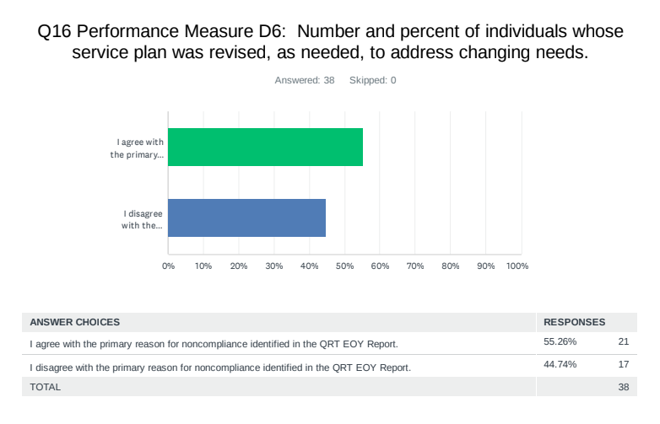
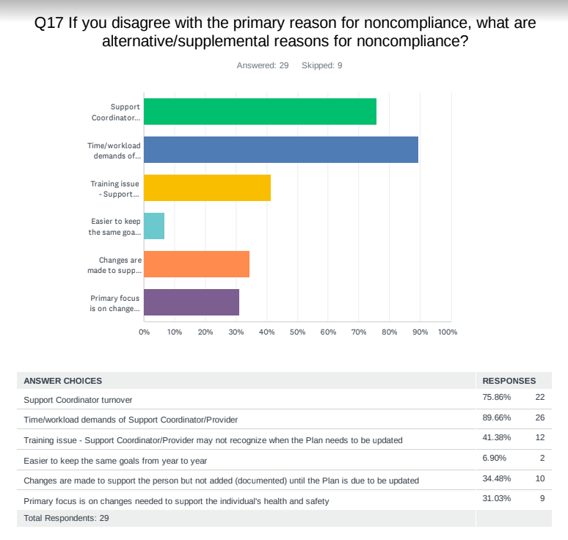
Highlights of CSB Feedback Questionnaire, cont’d.
PM #C6: Number and percent of individuals whose service plan was revised, as needed, to address changing needs
Notes:
PM D6, the Number and percent of individuals whose service plan was revised, as needed, to address changing needs) represented the largest difference (so the # of CSB’s that agreed with the reasons for noncompliance was lowest for this PM). In terms of the specific reasons why CSB’s believed that plans were not being updated when support needs changed, the top two reasons identified were 1.) SC/Provider work demands (89.66) and 2.) SC turnover (75.86).

Slide 13
Highlights of CSB Feedback Questionnaire, cont’d.
Most commonly occurring remediation activities reported:
Provider Roundtable/SC Meetings (35.7%),
CSB worked w/individual providers (26.56%),
DBHDS Training and TA (26.43%).
Most frequently occurring CSB comment (7) was a request for CSB-specific performance data.
Second most frequently occurring comment (5) included a request for ongoing training on risk mitigation using the RAT.
Overall rating of CSB review process (report and feedback tool ranged from 4/3 on a 5 point scale.
Notes:
The most commonly occurring remediation activities reported by CSBs (Provider Roundtable/SC Meetings (35.7%), CSBs worked w/individual providers (26.56%), and slightly fewer providers indicated that they received/requested DBHDS Training and TA (26.43%).
So CSB’s were asked for specific feedback on individual PM’s and overall feedback. Most frequently occurring CSB comment (7) was a request for annual CSB-specific performance data. The response from the QRT will be that the QRT neither reviews nor reports CSB-specific data. Citation data is sent directly to the provider/CSB and the CRC in their region. Further, DMAS reviews CSC’s over a three year period. We do collect the number of CAP’s per waiver for a particular PM and I can certainly add that to next year’s report. A CAP can represent multiple records cited…
Second most frequently occurring comment (5) included a request for ongoing training on risk mitigation using the RAT.
When asked for an overall rating of the QRT review process, the scores averaged between a 4 and a 3. I will follow up on all comments.

Slide 14
Deanna.Parker@dbhds.Virginia.gov (804) 773-9778

